Slide 1

Participating in Learning Management Systems through an iOS Application
Author: Nityananda Zbil
Supervisor: Prof. Dr. Stephan Krusche
Technische Universität München
TUM School of Computation, Information and Technology
Chair for Applied Software Engineering
Munich, 5. April 2024
Notes:
Good Morning everyone!
I present you my thesis!

Slide 2
Outline
Problem
Motivation
Objectives
Requirements Analysis
System Design
Demo
Evaluation
Status
Future Work
Notes:
First, we discuss why we want to contribute to Artemis
🔴
That is the Problem, Motiviation, and Objectives
🔴
Next, we examine how we did it
🔴
That is the Requirements Analysis and System Design
🔴
Last but not least, does our implementation actually work?
🔴
I will show you a demo of the realized use cases
🔴
And we take a look at the evaluation, the current status and future work

Slide 3
Problem
🧑‍💻
Novice Users
🧑‍🏫
Advanced Users
📱
Deficient Usability
Notes:
Now
🔴
Many users depend on Artemis
🔴
We have novice users, for example, students in their first semester, who attend a course
🔴
On the other hand, we have advanced users, instructors and tutors, which use Artemis even more frequently
🔴
However, until now, the Artemis iOS app presents them with a deficient user interface

Slide 4
Motivation
📈
Mobile Device Usage
♻️
Keep Students Involved
Notes:
Why do would we want to use the iOS app, you might ask
🔴
Mobile devices usage is at its highest level
🔴
We can imagine that some students even prefer tablets over laptops
🔴
But we will only look at mobile phones
🔴
Secondly, we want to keep students involved
🔴
Let users communicate and collaborate directly through Artemis
🔴
At the tip of their fingers

Slide 5
Objectives
💬
Strengthen Fundamentals
🔇
Manage Push Notifications
🔗
Mention Course Contents
Notes:
This work is concerned with the communication feature
🔴
So far the iOS app underperforms in this area
🔴
We make sure to strengthen its fundamentals
🔴
And connect to the Artemis server efficiently
🔴
Even though we want students to be involved
🔴
we do not want to interrupt them all the time
🔴
To make the iOS app more fun
🔴
We want to enable users to mention content throughout the course

Slide 6
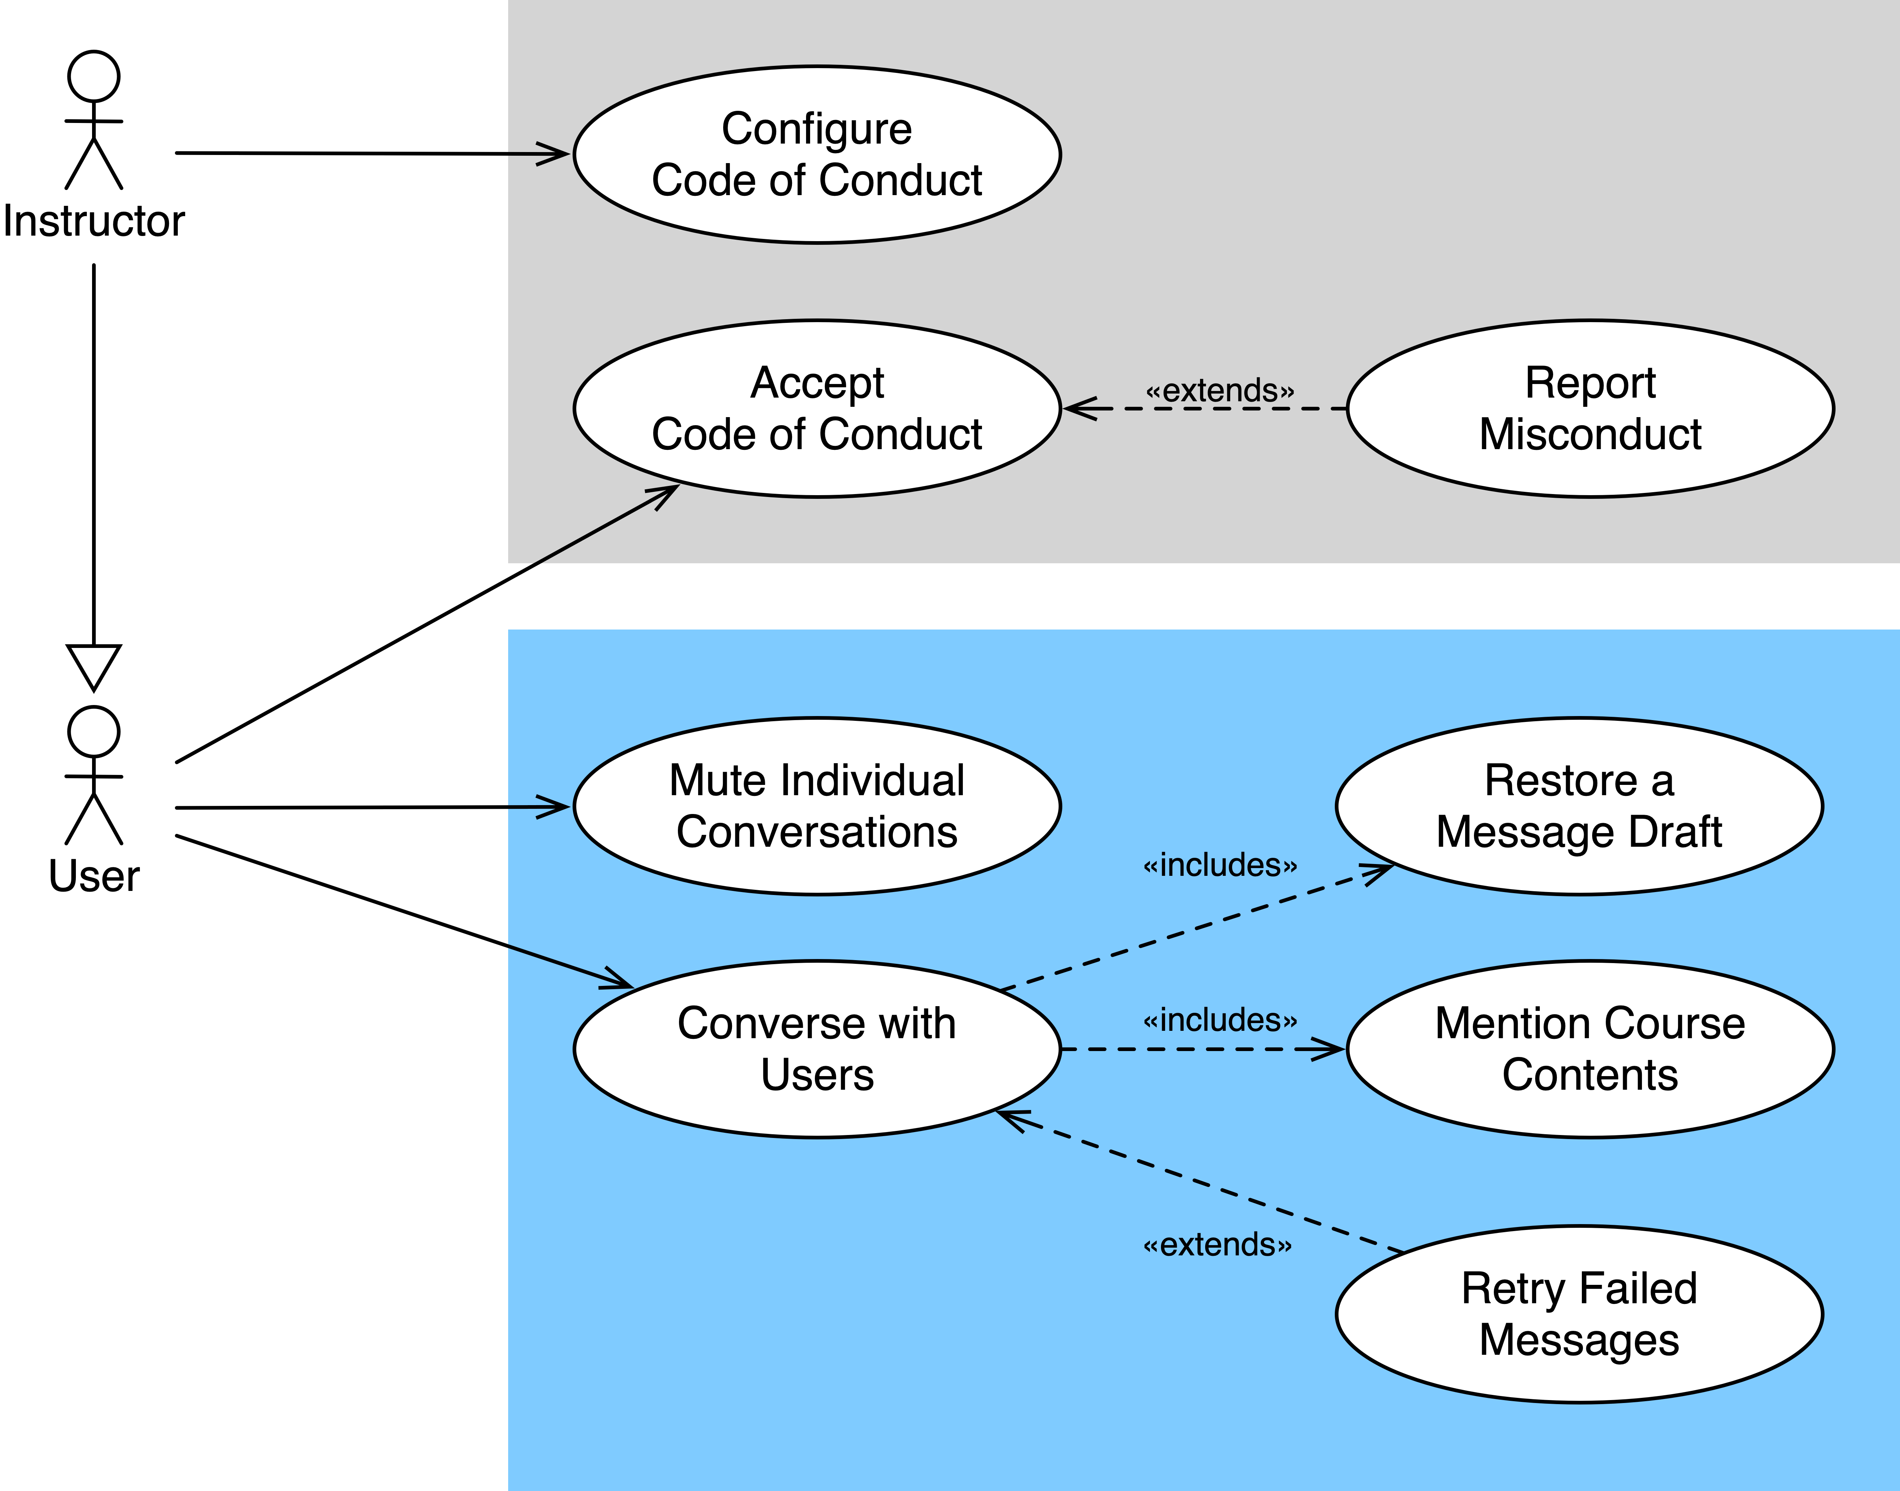
Requirements Analysis
Use Cases
Notes:
Let's look at the use cases in more detail
🔴
At the top we have use cases concerning the code of conduct
🔴
A code of conduct is required by the App Store Guidelines
🔴
if the service shows user-generated content

Slide 7
Requirements Analysis
Analysis Object Model

Slide 8
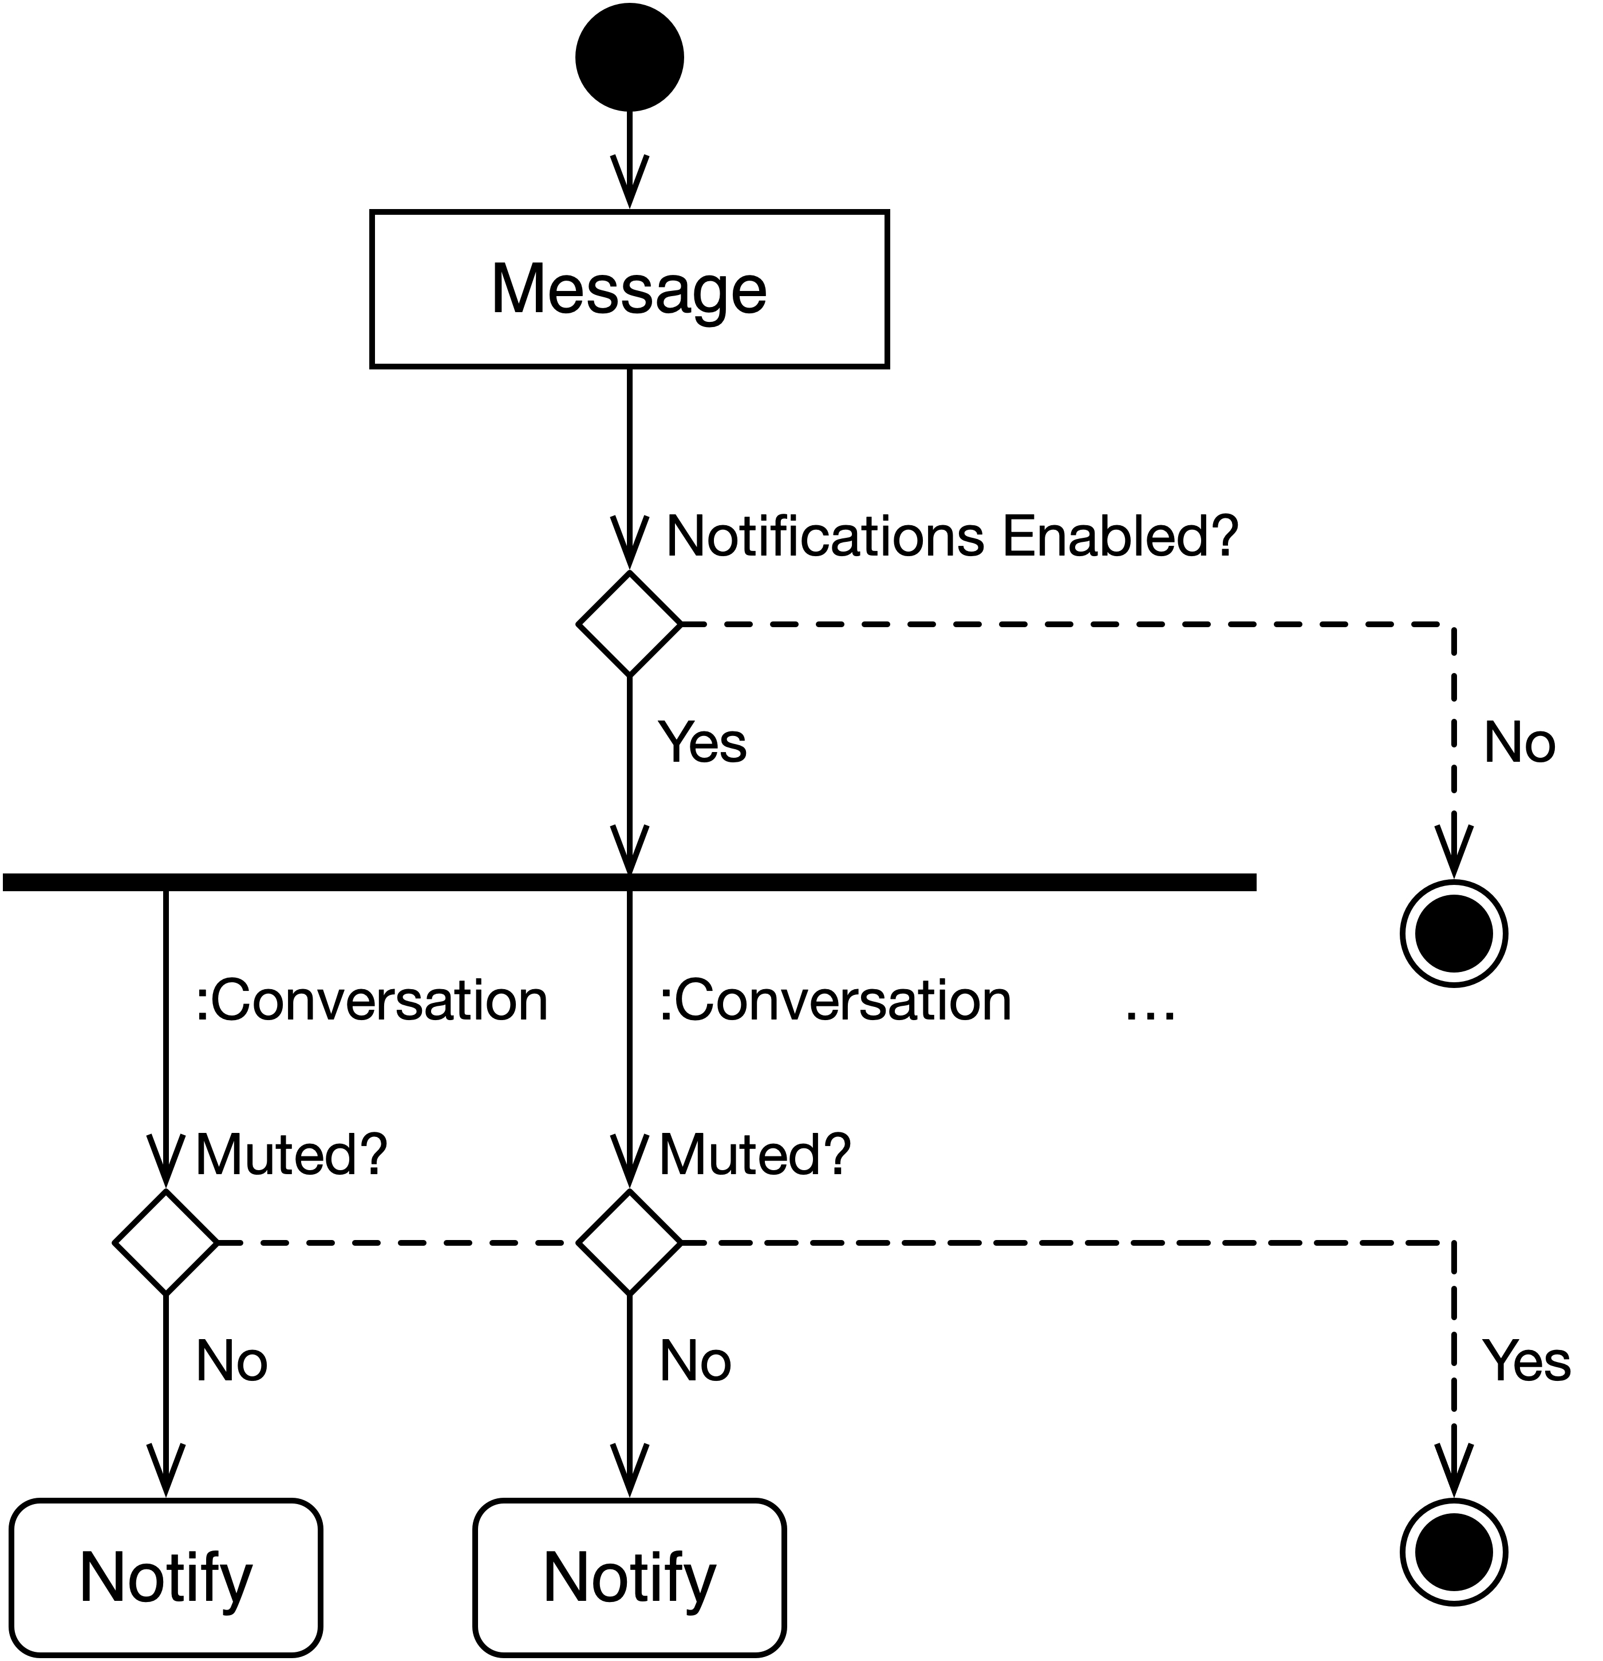
Requirements Analysis
Dynamic Model

Slide 9
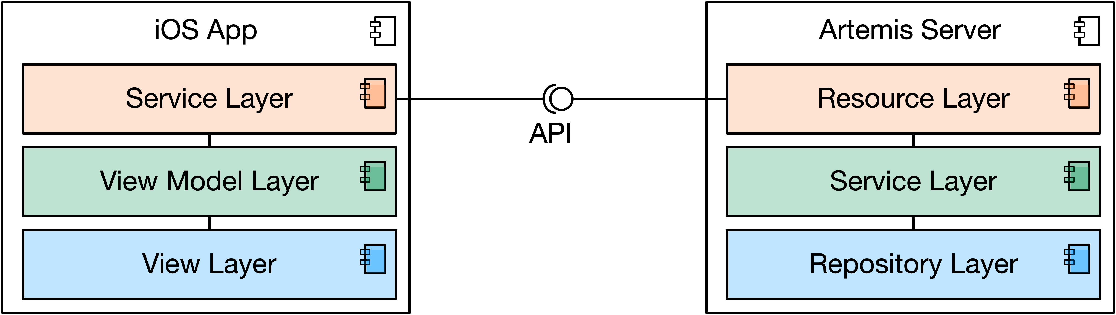
System Design
Top Level Design
Notes:
We recognize

Slide 10
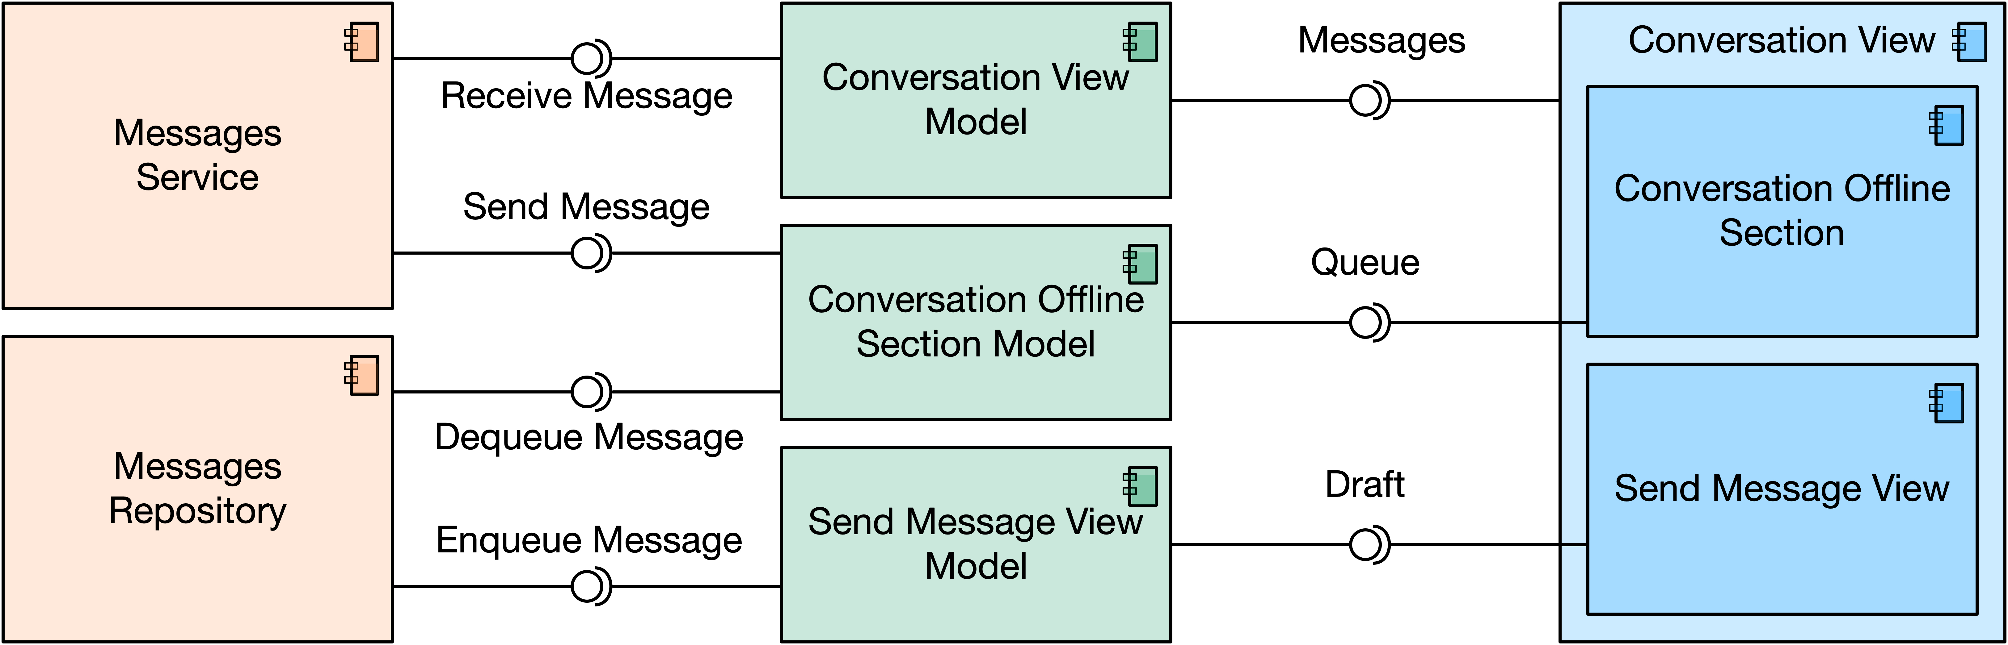
System Design
Subsystem Decomposition

Slide 11
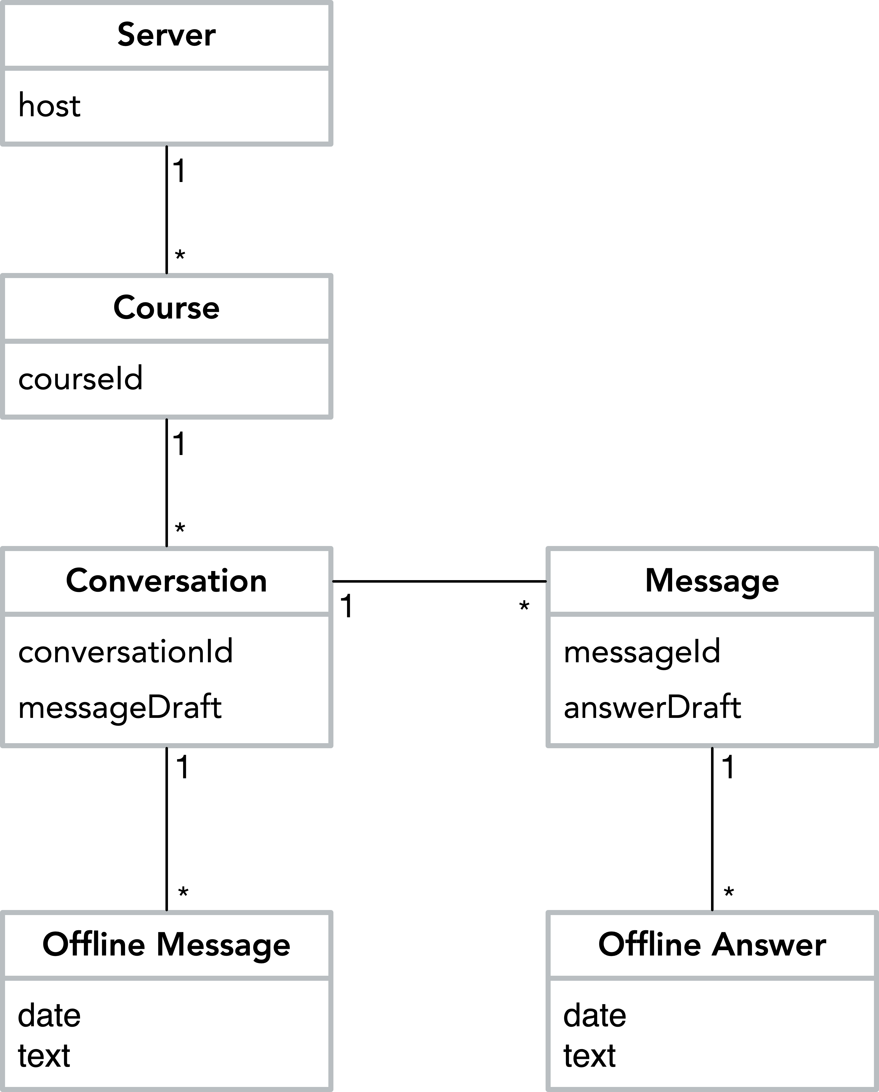
System Design
Persistent Data Management

Slide 12
Demo

Slide 13
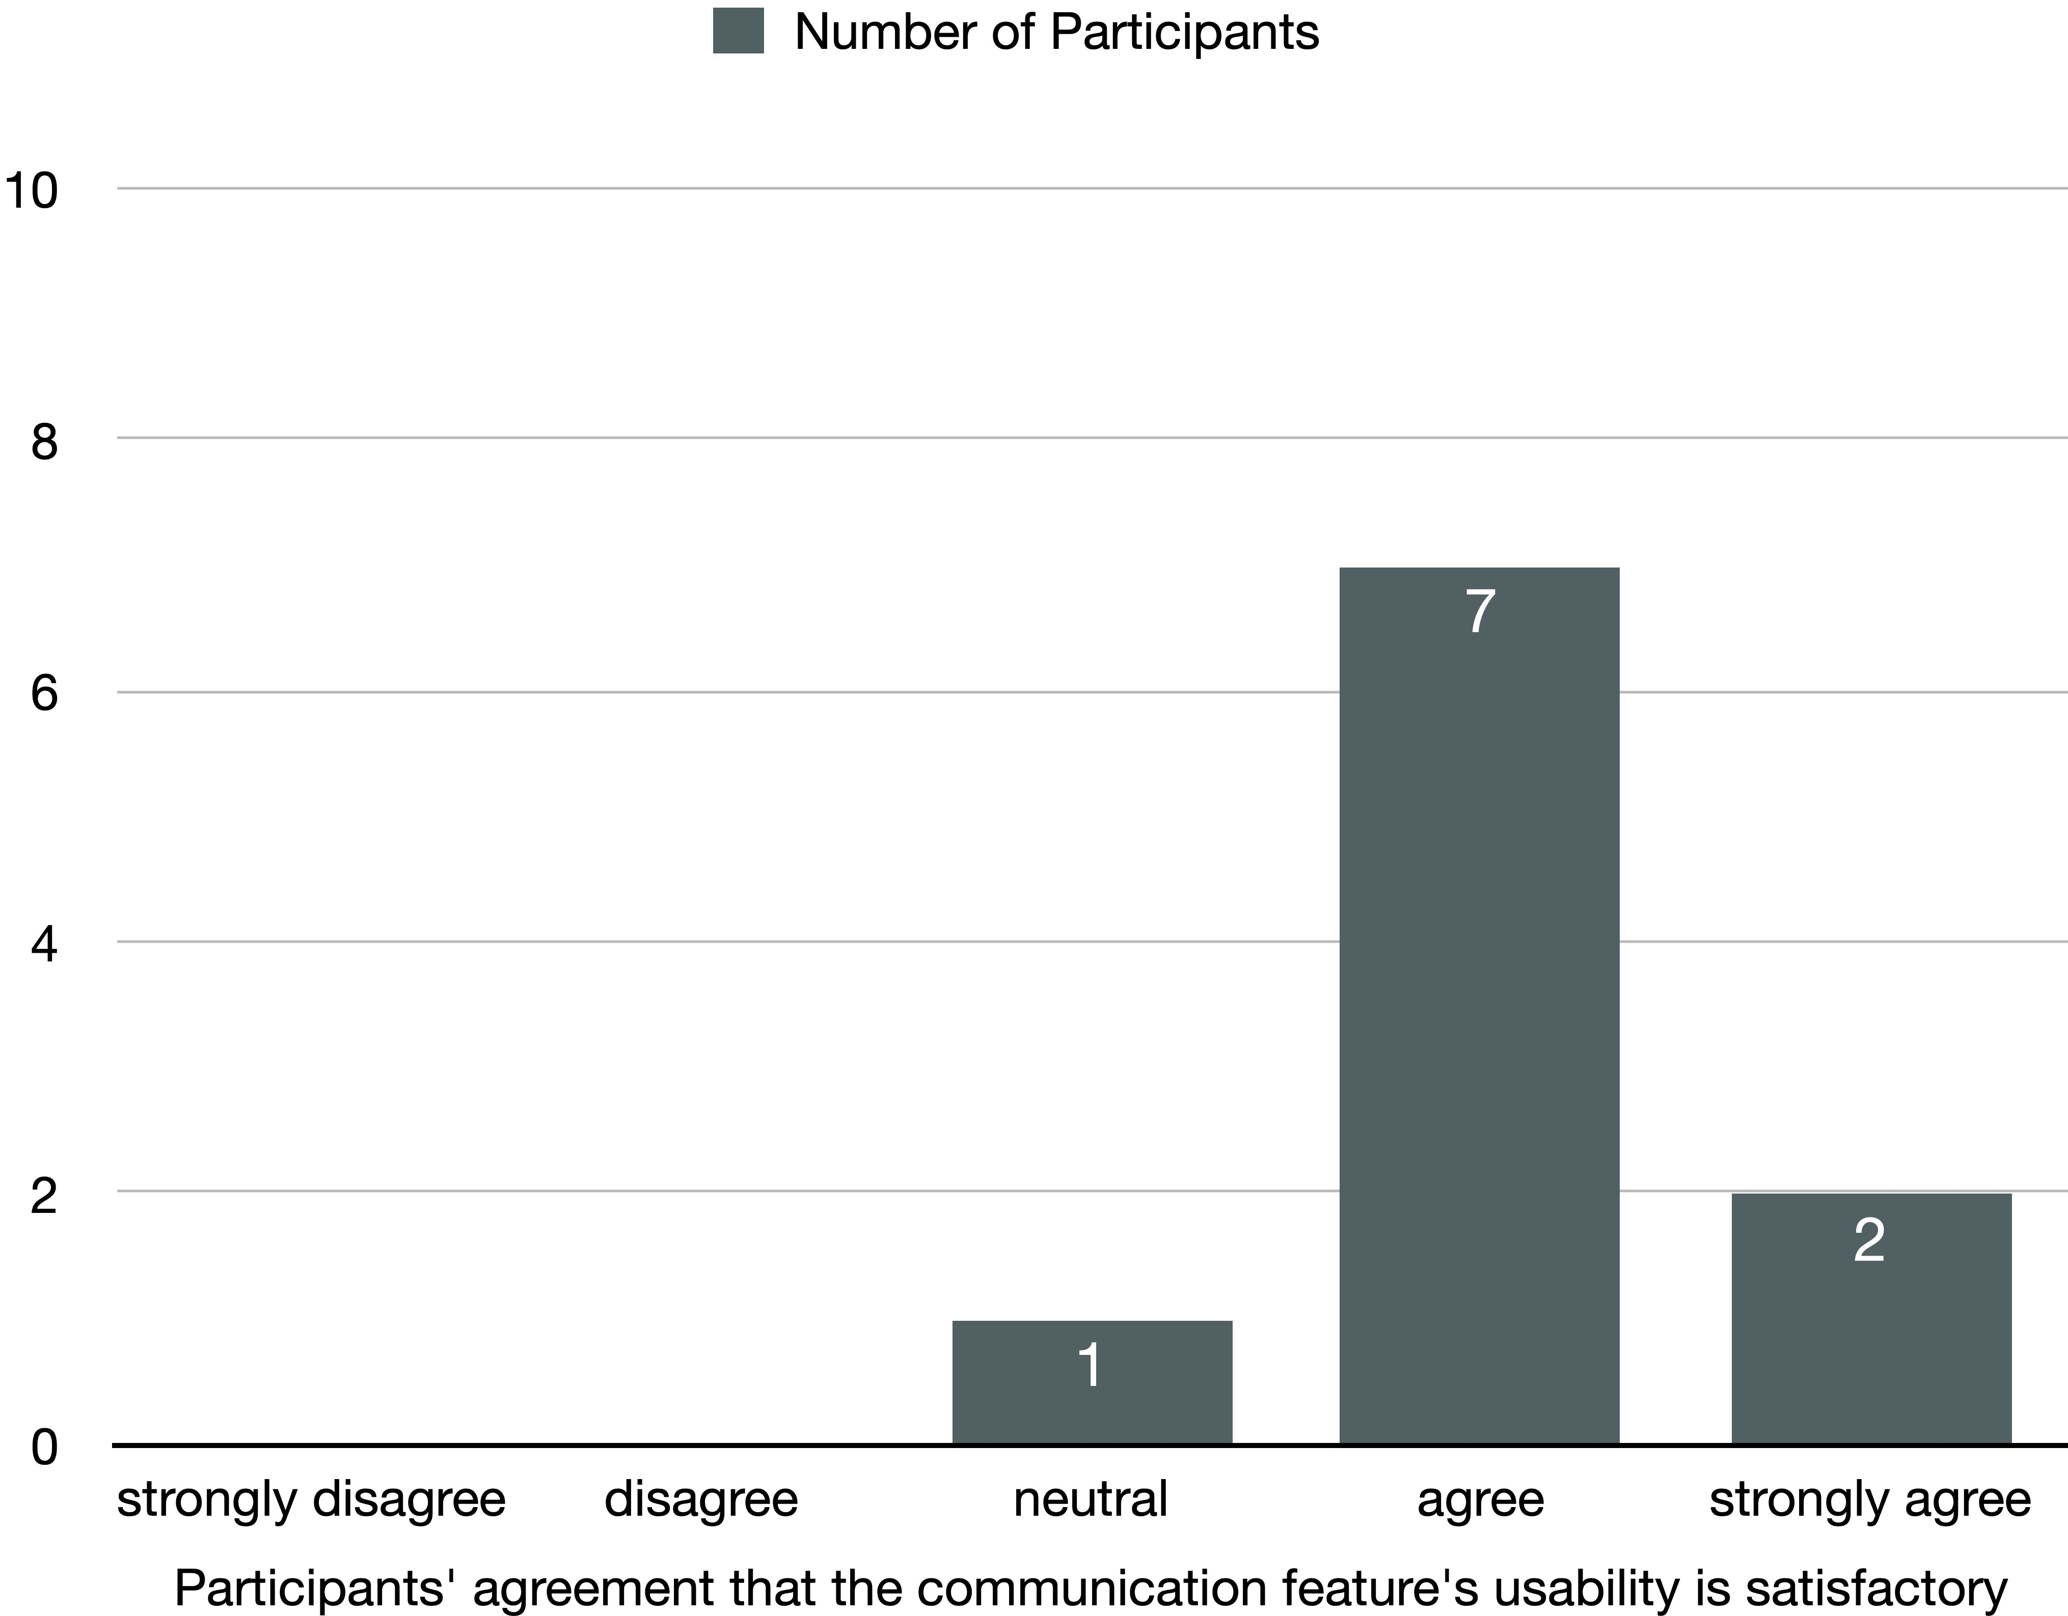
Evaluation
Manual Test
3 Tasks
10 Participants

Slide 14
Status
✅
Use Cases
✅ Realized
⚙️ Partially realized
✅
✅
✅
✅
⚙️
⚙️
✅

Slide 15
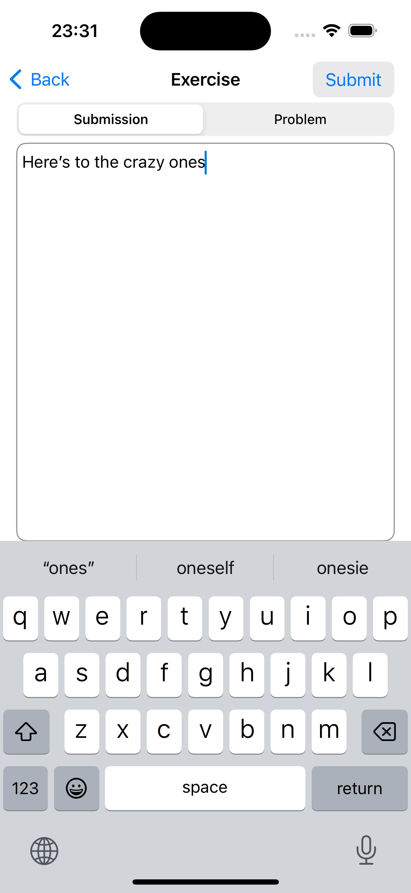
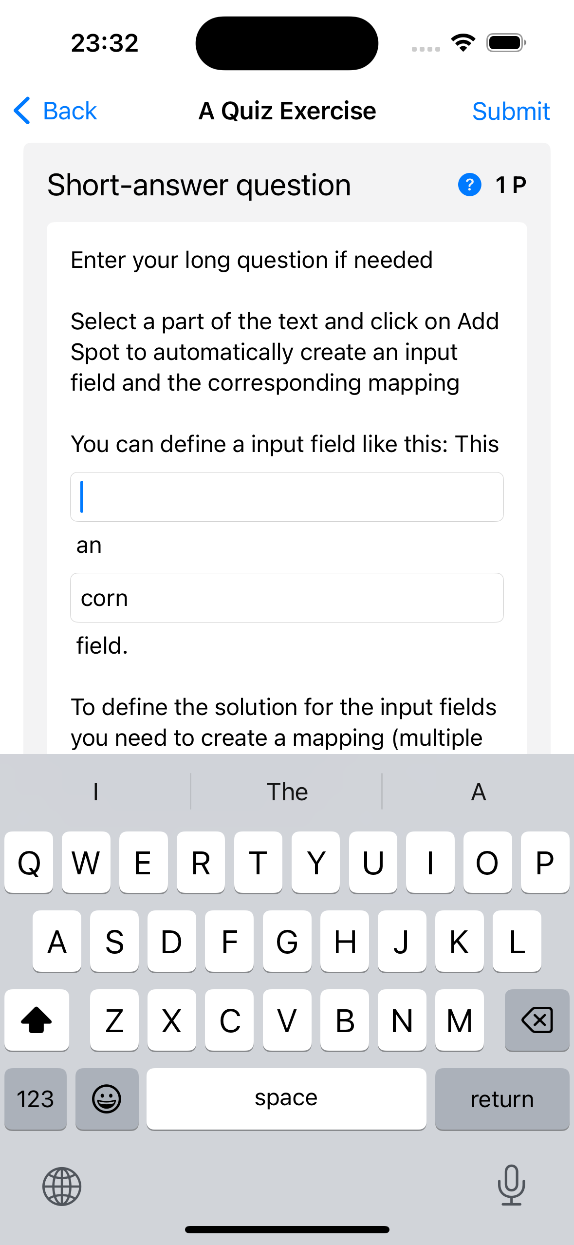
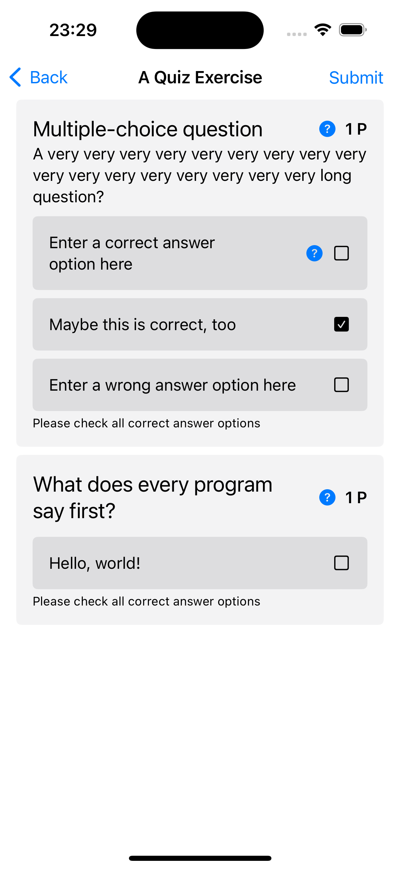
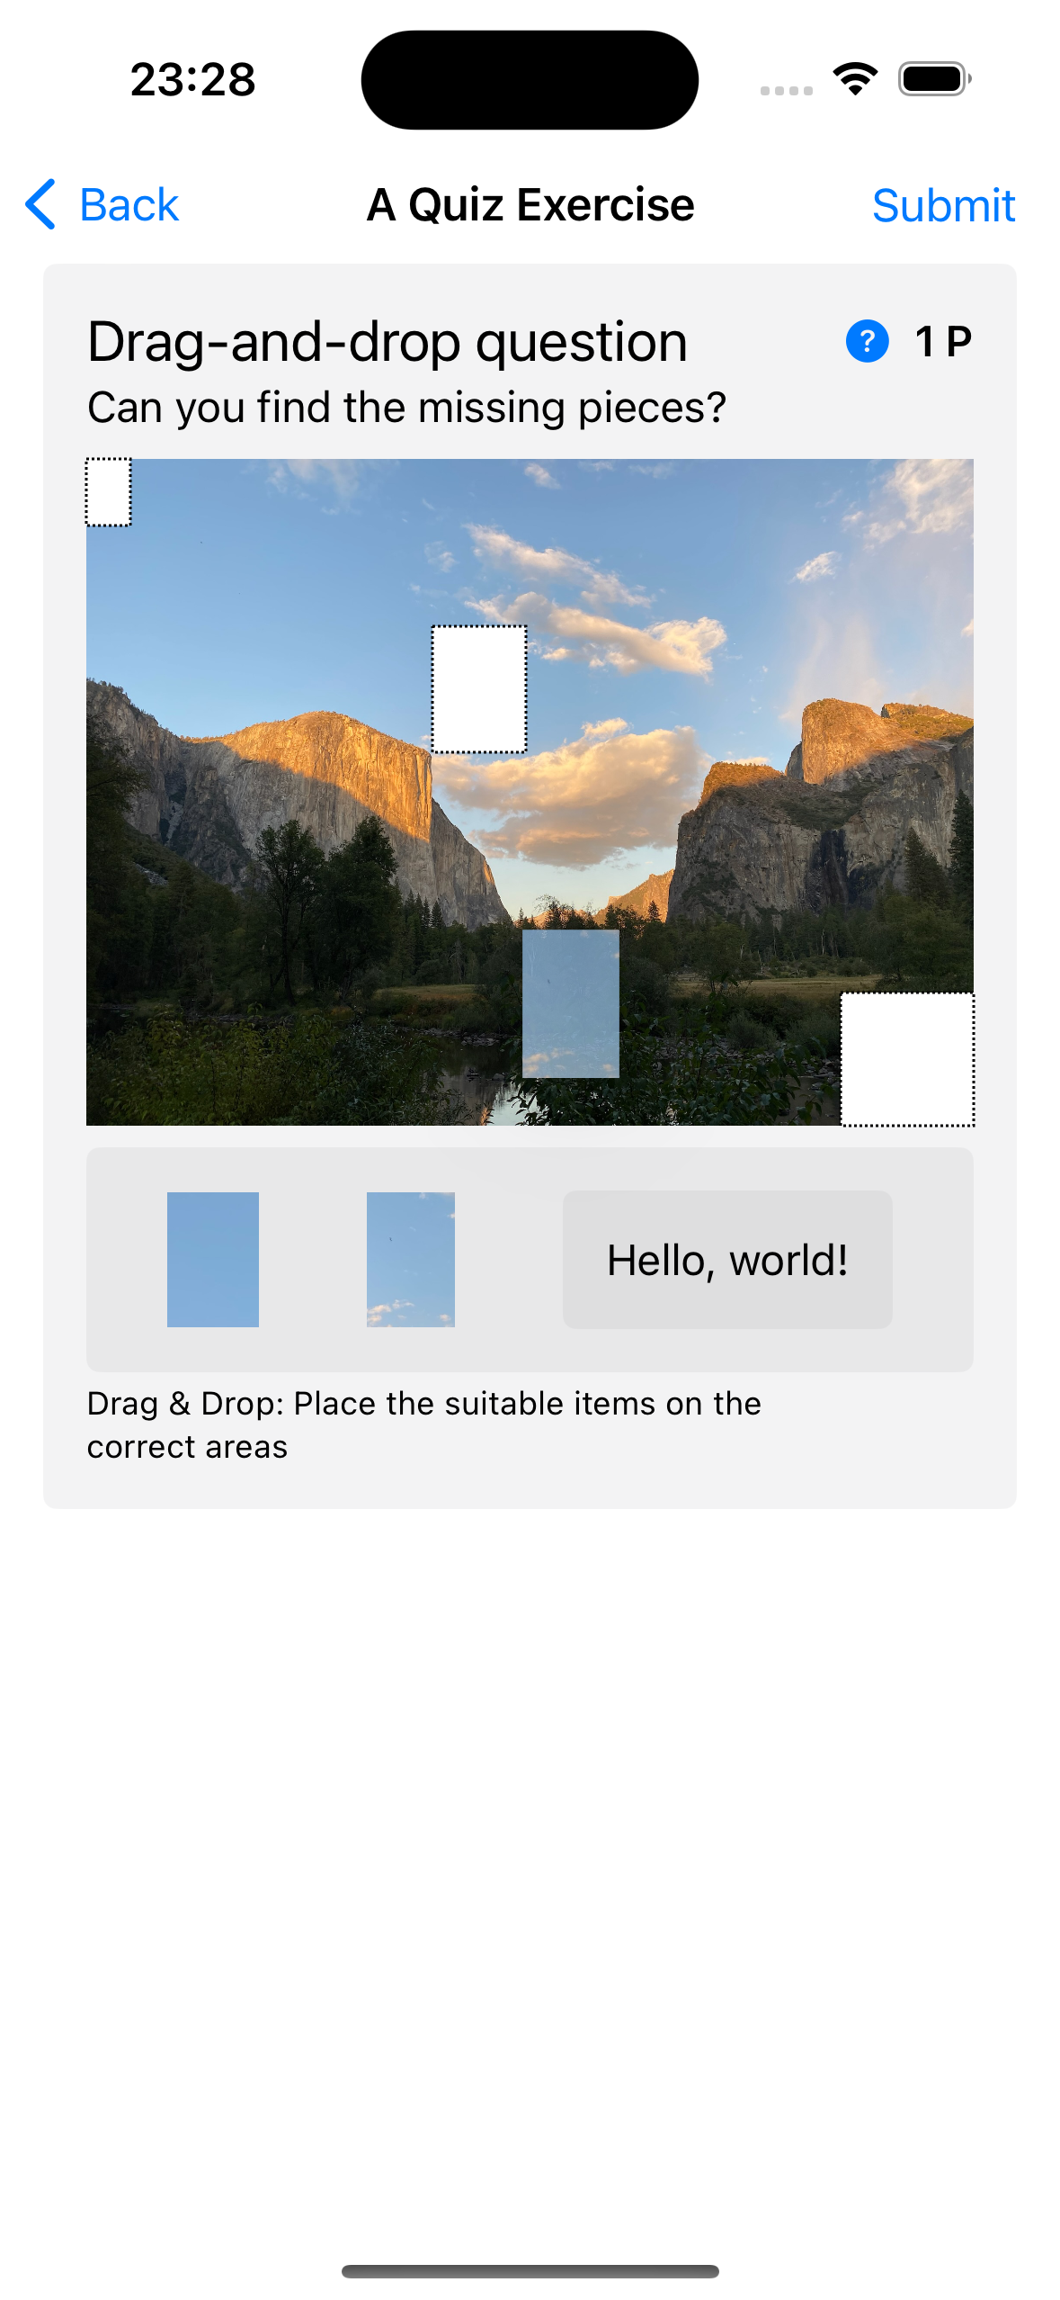
Future Work
Participation in Exercises

Slide 16
Thank You!

